Slide 1
March 22, 2019
Metaphors for Culture

Slide 2
Four Analogies
Kate Berardo

Slide 3
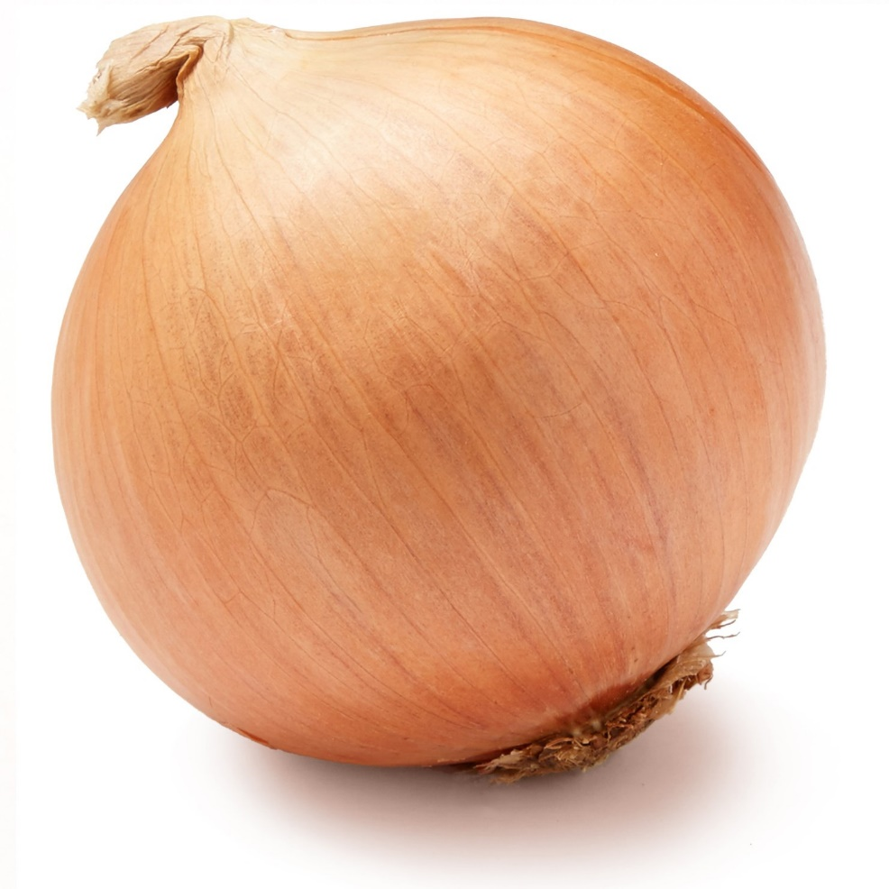
Onion
Notes:
According to Berardo (2012): “Like an onion, people are shaped by many layers of culture: national culture, regional culture, organizational culture, and many other types of culture (gender, religion, family, etc.)” (p. 62).
When we focus on only one layer, we can fall back on ideas of “us” vs. “them.” This also reduces a person to a single layer and not a complex being (p. 62).

Slide 4
Iceberg
Notes:
Culture is also like an iceberg: there are elements that are visible above the water and hidden elements below the water. These hidden elements represent the deeper, often invisible, elements of culture. By focusing only on the visible, we miss important pieces and can easily stereotype a culture. However, it is more difficult to adapt to these deeper elements (Berardo, 2012, p. 62).

Slide 5
Fish in Water
Notes:
According to Berardo (2012): “Like water to a fish, the influence of our own culture is often invisible to us: It is simply what we know and what we depend on for survival” (p. 62).
When we become like a “fish out of water,” then we can start to recognize our culture and our dependency on it (Berardo, 2012, p. 62).

Slide 6
Lenses
Notes:
According to Berardo (2012), since all “culture is a system for making meaning of things, and as a result, we all wear cultural lens or filters when we interpret a situation” (p. 62).
Like the fish out of water, we have to work to recognize our own lenses (Berardo, 2012, p. 62).

Slide 7
Other Metaphors for “Culture”
Jennifer E. Beer

Slide 8
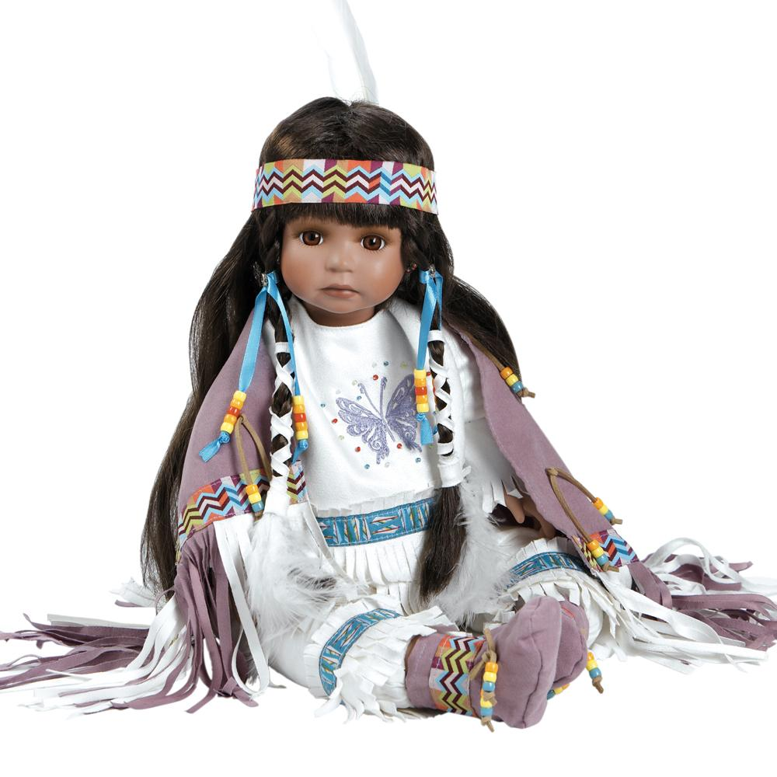
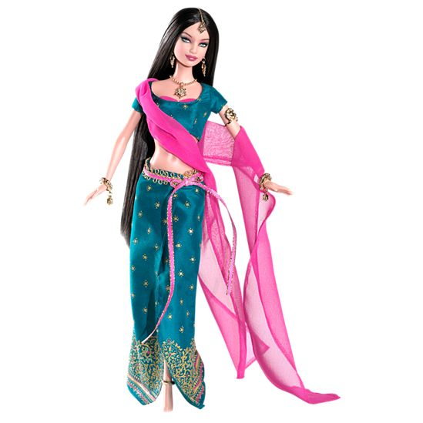
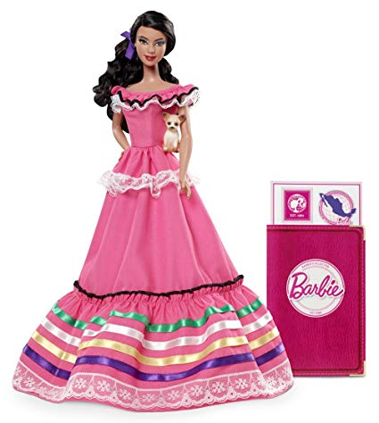
Dolls & Festive Natives
Notes:
According to Jennifer E. Beer (1997-2003), “The stock metaphor for culture in popular culture is pictures (usually of women) or of dolls dressed in festive native costume” (n.p.).
These images are of the “Other” and focus on the visible aspects of culture (above the water line in the iceberg metaphor). They are usually unthreatening (Beer).

Slide 9
Force Fields
Notes:
According to Jennifer E. Beer (1997-2003), force fields are invisible but “unifying and powerful.” This suggests that culture is dynamic and “beyond individual control” (n.p.)

Slide 10
Culture Shock
Notes:
Culture shock is the term for the difficult experience of adapting to a new culture.

Slide 11
Around the Campfire
Notes:
Jennifer E. Beer refers to Deal & Kennedy’s Corporate Culture for this term, which suggests that culture is “‘primitive,’ powerful, timeless, and that a strong head man can reshape it” (n.p.)

Slide 12
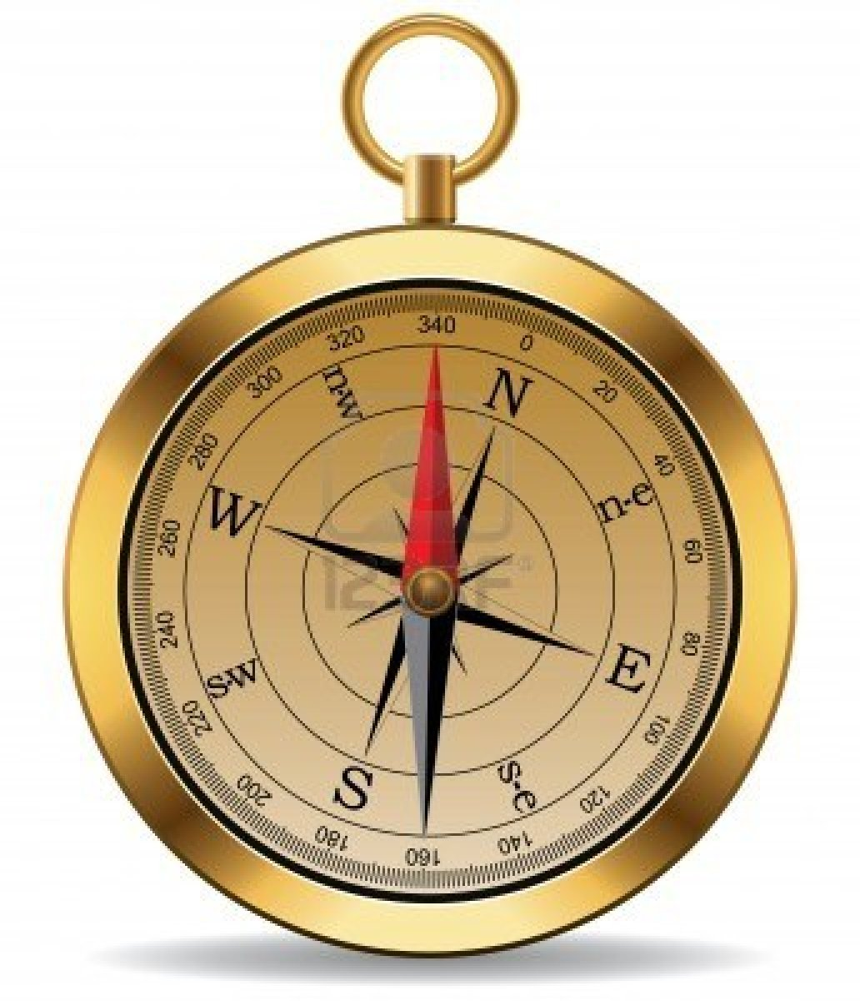
Compass or X mark
Notes:
According to Jennifer E. Beer (1997-2003), the compass is a geographic and scientific term that “locates culture on a two-dimensional line” and “produces a numeric… location for each given culture” (n.p.) This is an easy to understand metaphor.

Slide 13
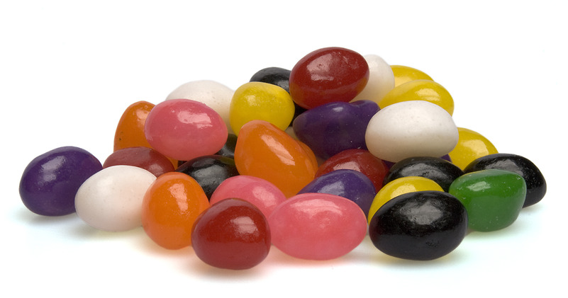
Jelly Beans
Notes:
Jennifer E. Beer uses Roosevelt Thomas’ term. All jelly beans are equally diverse and different.

Slide 14
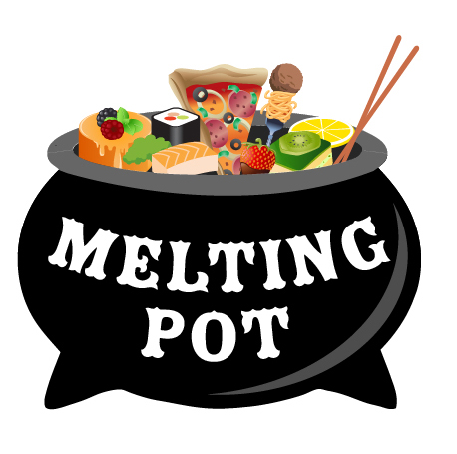
Melting Pots & Salad Bowls
Notes:
These are common metaphors for a culture within a dominant culture. The melting pot shows how all cultures “melt” together and suggests assimilation. However, the salad bowl shows how each item is maintained. However, as Beer notes, in each metaphor, the “culture” gets “eaten and assimilated in the end” (n.p.)

Slide 15
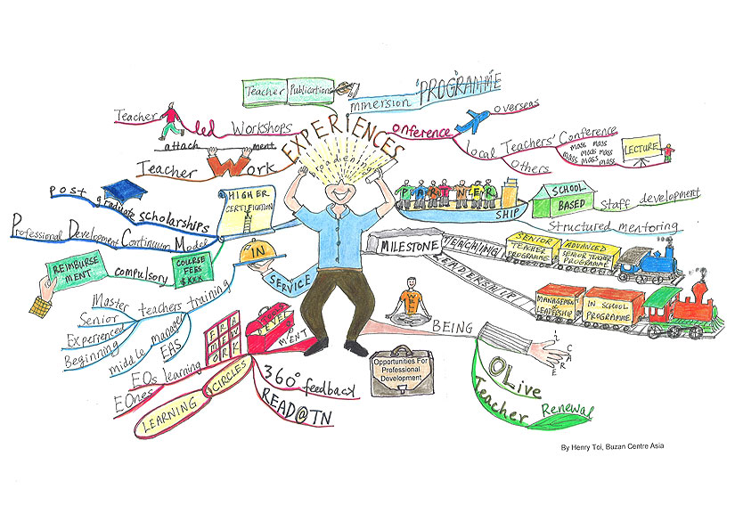
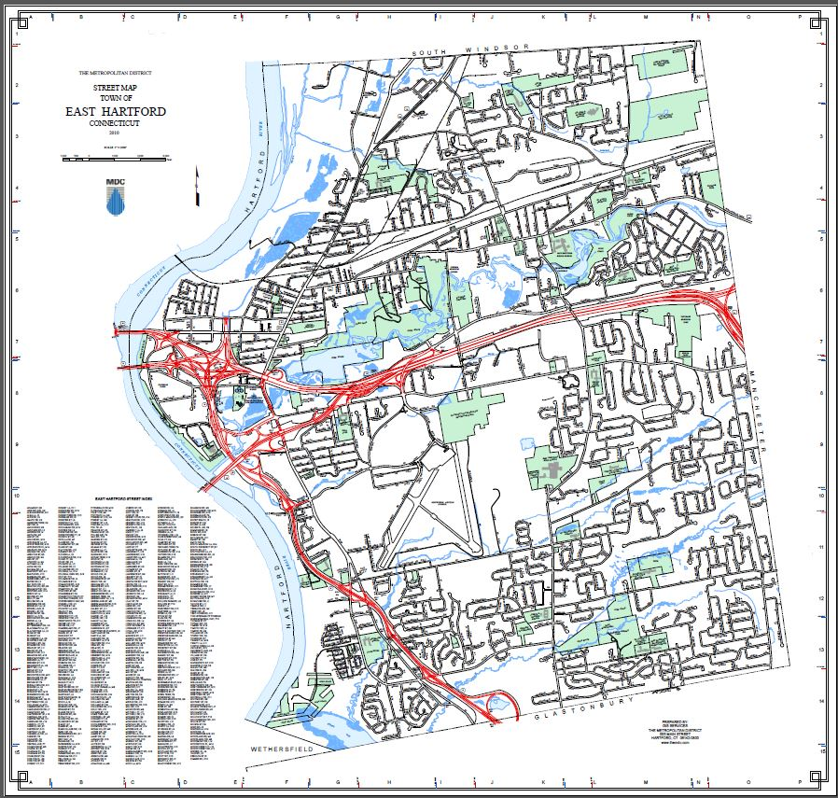
Mind Maps
Notes:
According to Jennifer E. Beer (1997-2003), the mind map “depicts the network of associative links in our minds,” and these associations are “partly personal, partly collective” (n.p.)

Slide 16
Celebration!
Notes:
According to Jennifer E. Beer (1997-2003), by saying that we “celebrate” diversity, this suggests that we honor their “special events” (n.p.) However, this also suggests that multiculturalism is “decorative” and not for the everyday (Beer n.p.)

Slide 17
Organism
Notes:
According to Jennifer E. Beer (1997-2003), the organism makes culture into something living (n.p.). However, the organism controls boundaries and suggests “keeping out foreign intrusions” (Beer n.p.)

Slide 18
Chaos!
Notes:
According to Jennifer E. Beer (1997-2003), chaos suggests that “culture is too difficult to ‘manage’” (n.p.).

Slide 19
Software of the Mind
Notes:
According to Jennifer E. Beer (1997-2003), this term references Hofstede’s book, Software of the Mind. It describes how the “boundary between what is human and what is machine is increasingly hard to maintain” (Beer n.p.). The brain is the computer’s CPU and culture is the software (n.p.).

Slide 20
Works Cited
Beer, J. E. (1997-2003). A picture is worth a thousand words… Metaphors for “culture.” Culture at Work. Retrieved from http://www.culture-at-work.com/concept2.html
Berado, K. (2012). Four analogies. In In K. Berardo & D. K. Deardorff (Eds.), Building cultural competence: Innovative activities and models (pp. 61-68). Sterling, VA: Stylus Publishing.

